Slide 1
Operating-System Structures
System Components
Operating System Services
System Calls

Slide 2
Common System Components
Process Management
Main Memory Management
Secondary-Storage Management
I/O System Management
File Management
Protection System
Networking
Command-Interpreter System

Slide 3
Process Management
A process is a program in execution. A process needs certain resources, including CPU time, memory, files, and I/O devices, to accomplish its task.
The operating system is responsible for the following activities in connection with process management.
Process creation and deletion.
process suspension and resumption.
Provision of mechanisms for:
process synchronization
process communication
Deadlock handling

Slide 4
Main-Memory Management
Memory is a large array of words or bytes, each with its own address. It is a repository of quickly accessible data shared by the CPU and I/O devices.
Main memory is a volatile storage device. It loses its contents in the case of system failure.
The operating system is responsible for the following activities in connections with memory management:
Keep track of which parts of memory are currently being used and by whom.
Decide which processes to load when memory space becomes available.
Allocate and deallocate memory space as needed.

Slide 5
Secondary-Storage Management
Since main memory (primary storage) is volatile and too small to accommodate all data and programs permanently, the computer system must provide secondary storage to back up main memory.
Most modern computer systems use disks as the principle on-line storage medium, for both programs and data.
The operating system is responsible for the following activities in connection with disk management:
Free space management
Storage allocation
Disk scheduling

Slide 6
I/O System Management
The I/O system consists of:
A buffer-caching system
A general device-driver interface
Drivers for specific hardware devices

Slide 7
File Management
A file is a collection of related information defined by its creator. Commonly, files represent programs (both source and object forms) and data.
The operating system is responsible for the following activities in connections with file management:
File creation and deletion.
Directory creation and deletion.
Support of primitives for manipulating files and directories.
Mapping files onto secondary storage.
File backup on stable (nonvolatile) storage media.

Slide 8
Protection System
Protection refers to a mechanism for controlling access by programs, processes, or users to both system and user resources.
Multiple users
Concurrent execution of processes
The protection mechanism must:
distinguish between authorized and unauthorized usage.
specify the controls to be imposed.
provide a means of enforcement.

Slide 9
Networking (Distributed Systems)
A distributed system is a collection processors that do not share memory or a clock. Each processor has its own local memory.
The processors in the system are connected through a communication network.
A distributed system provides user access to various system resources.
Access to a shared resource allows:
Computation speed-up
Increased data availability
Enhanced reliability

Slide 10
Command-Interpreter System
Many commands are given to the operating system by control statements which deal with:
process creation and management
I/O handling
secondary-storage management
main-memory management
file-system access
protection
networking

Slide 11
Command-Interpreter System (Cont.)
The program that reads and interprets control statements is called variously:
control-card interpreter
command-line interpreter
shell (in UNIX)
Its function is to get and execute the next command statement.

Slide 12
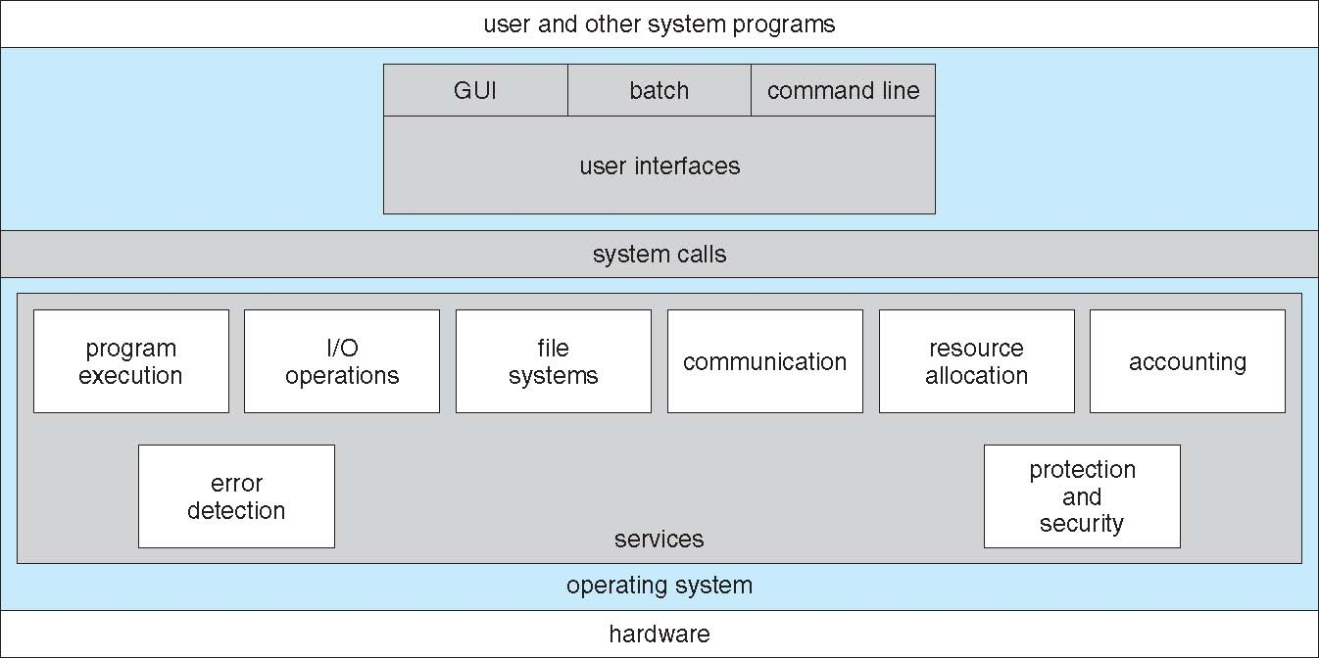
A view of OS services

Slide 13
Operating System Services
One set of operating-system services provides functions that are helpful to the user:
User interface - Almost all operating systems have a user interface (UI)
Varies between Command-Line (CLI), Graphics User Interface (GUI), Batch
User-friendly desktop metaphor interface
Usually mouse, keyboard, and monitor
Icons represent files, programs, actions, etc
Various mouse buttons over objects in the interface cause various actions (provide information, options, execute function, open directory (known as a folder)
Invented at Xerox PARC

Slide 14
Operating System Services
Many systems now include both CLI and GUI interfaces
Microsoft Windows is GUI with CLI “command” shell
Apple Mac OS X as “Aqua” GUI interface with UNIX kernel underneath and shells available
Solaris is CLI with optional GUI interfaces (Java Desktop, KDE)

Slide 15
Operating System Services
Program execution – system capability to load a program into memory and to run it.
I/O operations – since user programs cannot execute I/O operations directly, the operating system must provide some means to perform I/O.
File-system manipulation – program capability to read, write, create, and delete files.

Slide 16
Operating System Services (contd..)
One set of operating-system services provides functions that are helpful to the user (cont.):
Communications – Processes may exchange information, on the same computer or between computers over a network
Communications may be via shared memory or through message passing (packets moved by the OS)
Error detection – OS needs to be constantly aware of possible errors
May occur in the CPU and memory hardware, in I/O devices, in user program
For each type of error, OS should take the appropriate action to ensure correct and consistent computing
Debugging facilities can greatly enhance the user’s and programmer’s abilities to efficiently use the system

Slide 17
Additional Operating System Functions
Another set of OS functions exists for ensuring the efficient operation of the system itself via resource sharing
Resource allocation - When multiple users or multiple jobs running concurrently, resources must be allocated to each of them
Many types of resources - Some (such as CPU cycles, main memory, and file storage) may have special allocation code, others (such as I/O devices) may have general request and release code
Accounting - To keep track of which users use how much and what kinds of computer resources

Slide 18
Additional Operating System Functions (contd..)
Protection and security - The owners of information stored in a multiuser or networked computer system may want to control use of that information, concurrent processes should not interfere with each other
Protection involves ensuring that all access to system resources is controlled
Security of the system from outsiders requires user authentication, extends to defending external I/O devices from invalid access attempts
If a system is to be protected and secure, precautions must be instituted throughout it. A chain is only as strong as its weakest link.

Slide 19
System Calls
Programming interface to the services provided by the OS
Typically written in a high-level language (C or C++)
Mostly accessed by programs via a high-level Application Program Interface (API) rather than direct system call use
Three most common APIs are Win32 API for Windows, POSIX API for POSIX-based systems (including virtually all versions of UNIX, Linux, and Mac OS X), and Java API for the Java virtual machine (JVM)

Slide 20
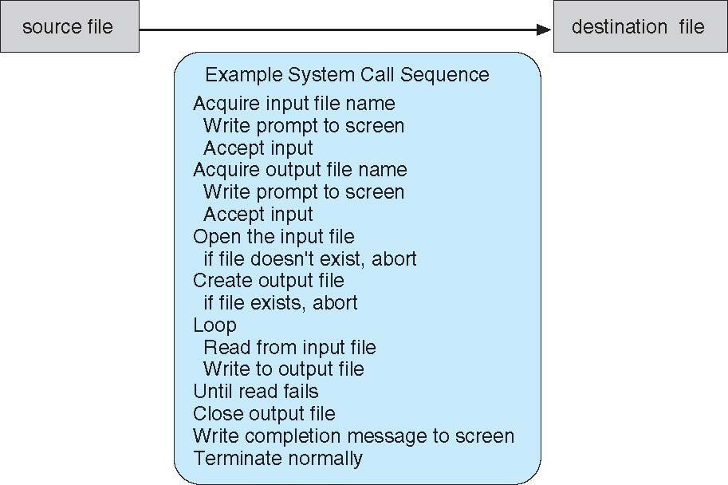
Example of System Calls
System call sequence to copy the contents of one file to another file

Slide 21
System Call implementation
Typically, a number associated with each system call
System-call interface maintains a table indexed according to these numbers
The system call interface invokes intended system call in OS kernel and returns status of the system call and any return values
The caller need know nothing about how the system call is implemented
Just needs to obey API and understand what OS will do as a result call
Most details of OS interface hidden from programmer by API
Managed by run-time support library (set of functions built into libraries included with compiler)

Slide 22
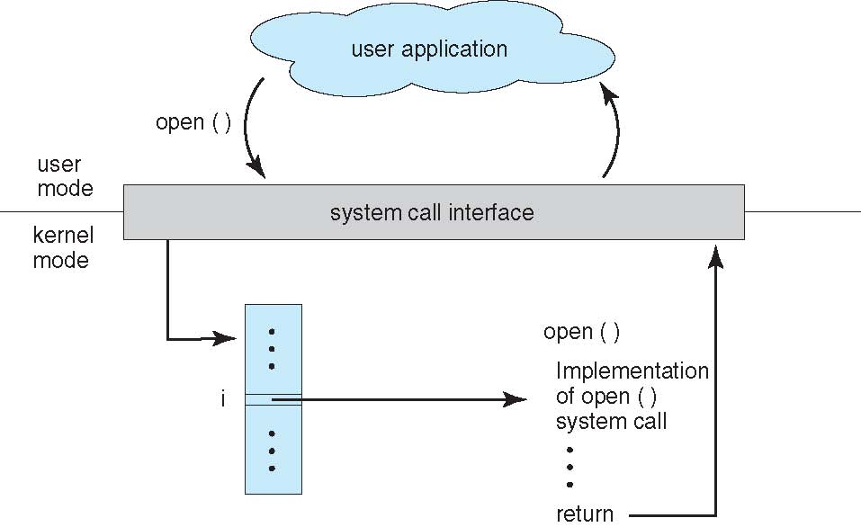
API-System call-OS relationship
Typically, a number associated with each system call
System-call interface maintains a table indexed according to these numbers
The system call interface invokes intended system call in OS kernel and returns status of the system call and any return values
The caller need know nothing about how the system call is implemented
Just needs to obey API and understand what OS will do as a result call
Most details of OS interface hidden from programmer by API
Managed by run-time support library (set of functions built into libraries included with compiler)

Slide 23
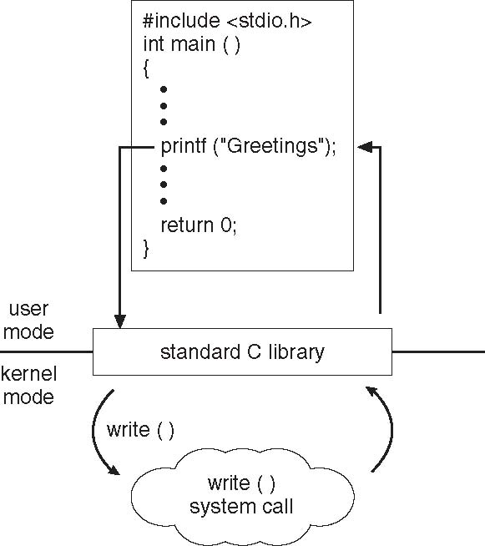
Standard C library example
C program invoking printf() library call, which calls write() system call

Slide 24
System Call Parameter Passing
Often, more information is required than simply identity of desired system call
Exact type and amount of information vary according to OS and call
Three general methods used to pass parameters to the OS
Simplest: pass the parameters in registers
In some cases, may be more parameters than registers
Parameters stored in a block, or table, in memory, and address of block passed as a parameter in a register
This approach taken by Linux and Solaris
Parameters placed, or pushed, onto the stack by the program and popped off the stack by the operating system
Block and stack methods do not limit the number or length of parameters being passed

Slide 25
MS-DOS Execution
At System Start-up
Running a Program

Slide 26
Communication Models
Msg Passing
Shared Memory

Slide 27
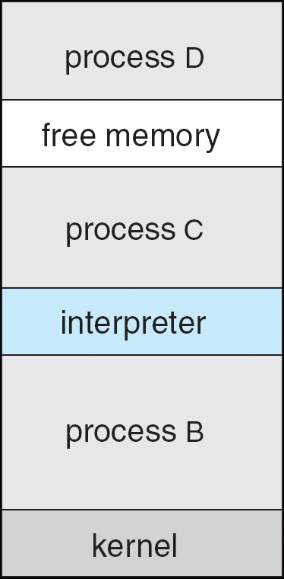
FreeBSD Running Multiple Programs

Slide 28
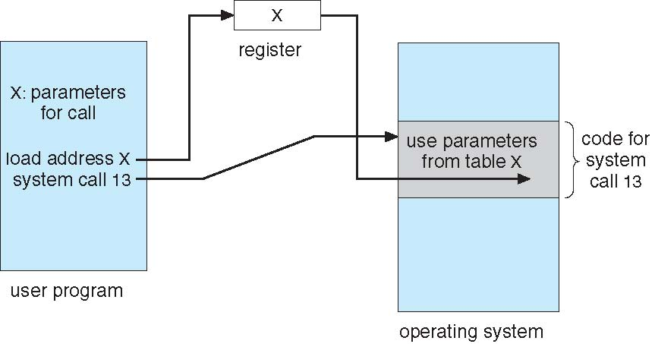
Passing of Parameters As A Table

Slide 29
Types of system calls
Process control
end, abort
load, execute
create process, terminate process
get process attributes, set process attributes
wait for time
wait event, signal event
allocate and free memory
• File manipulation
create file, delete file
open, close
read, write, reposition
get file attributes, set file attributes
• Device manipulation
request device, release device
read, write, reposition
get device attributes, set device attributes
logically attach or detach devices

Slide 30
Types of system calls
• Information maintenance
get time or date, set time or date
get system data, set system data
get process, file, or device attributes
set process, file, or device attributes
Communications
create, delete communication connection
send, receive messages
transfer status information
attach or detach remote devices

Slide 31
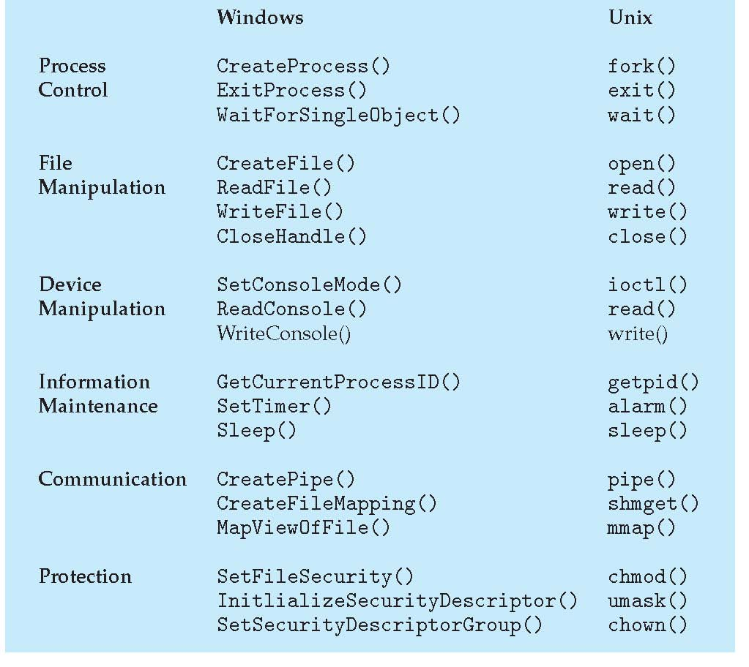
Examples of Windows and Unix System Calls

